Slide 1
Chapter 5 Requirements Engineering Process

Slide 2
Lesson Objectives
Explain what is requirement engineering
Describe the 5 activities in requirements engineering process
Discuss the problems in requirement analysis phase of software engineering
Explain and evaluate Viewpoint-oriented analysis

Slide 3
Introduction
What is Requirement engineering?
Requirement engineering is a process that involves all of the activities required to create and maintain a system requirements document.

Slide 4
Introduction
This process includes:
1. Feasibility Studies
2. Requirement Elicitation and Analysis
3. Requirement Specification (Discussed in Chapter 4)
4. Requirement Validation
5. Requirement Management

Slide 5

1. Feasibility Studies

Slide 6

1. Feasibility Studies
Technical Feasibility
An estimate is made of whether the identified user needs may be satisfied using current software and hardware technologies.

Slide 7

1. Feasibility Studies
Economical Feasibility
It will decide if the proposed system will be cost-effective and if it can be developed given existing budgetary constraints.

Slide 8
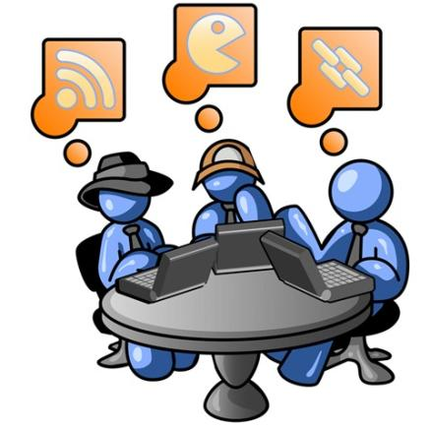
1. Feasibility Studies
Willingness & ability to operate, use & support
Management, employees, customers, suppliers
Operational Feasibility
8

Slide 9
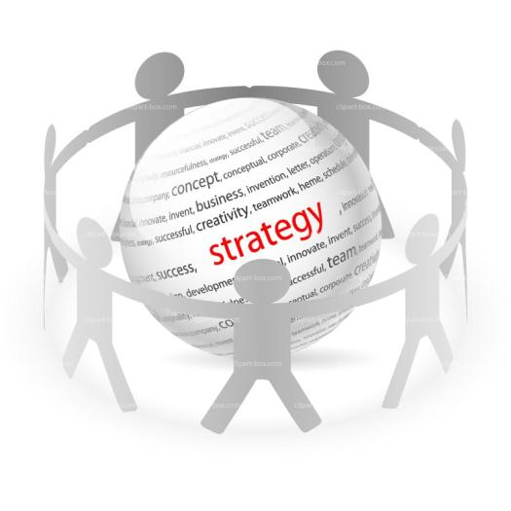
1. Feasibility Studies
Supports the strategic objectives?
Organizational Feasibility
9

Slide 10

1. Feasibility Studies
People accepts the system?
Social Feasibility
10

Slide 11

1. Feasibility Studies
Complete within the planned time
Schedule Feasibility

Slide 12
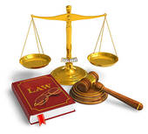
1. Feasibility Studies
Legally accepted
Legal Feasibility

Slide 13
1. Feasibility Studies
It should be relatively cheap and quickly. The result should inform the decision of whether to go ahead with a more detailed analysis.
STOP
GO

Slide 14
2. Requirements Analysis & Elicitation

Slide 15
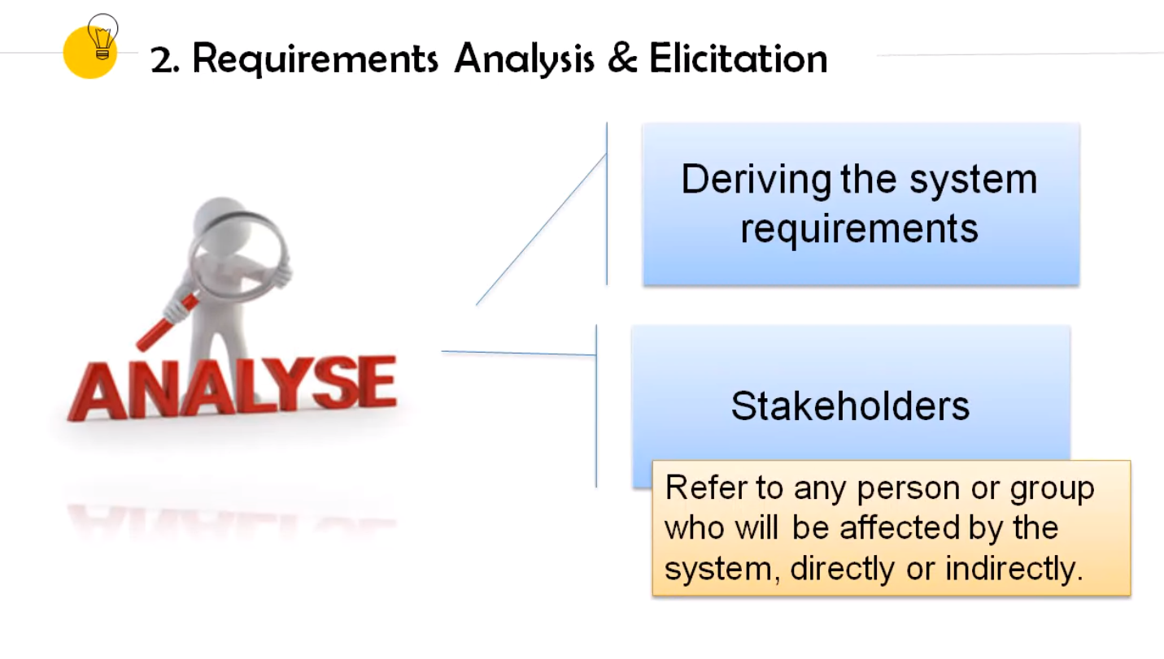

2. Requirements Analysis & Elicitation
This is the process of deriving the system requirements.
Software engineers works with stakeholders to find out about the application domain, what services should provide, the required performance, hardware constraints, and etc.
Refer to any person or group who will be affected by the system, directly or indirectly.

Slide 16
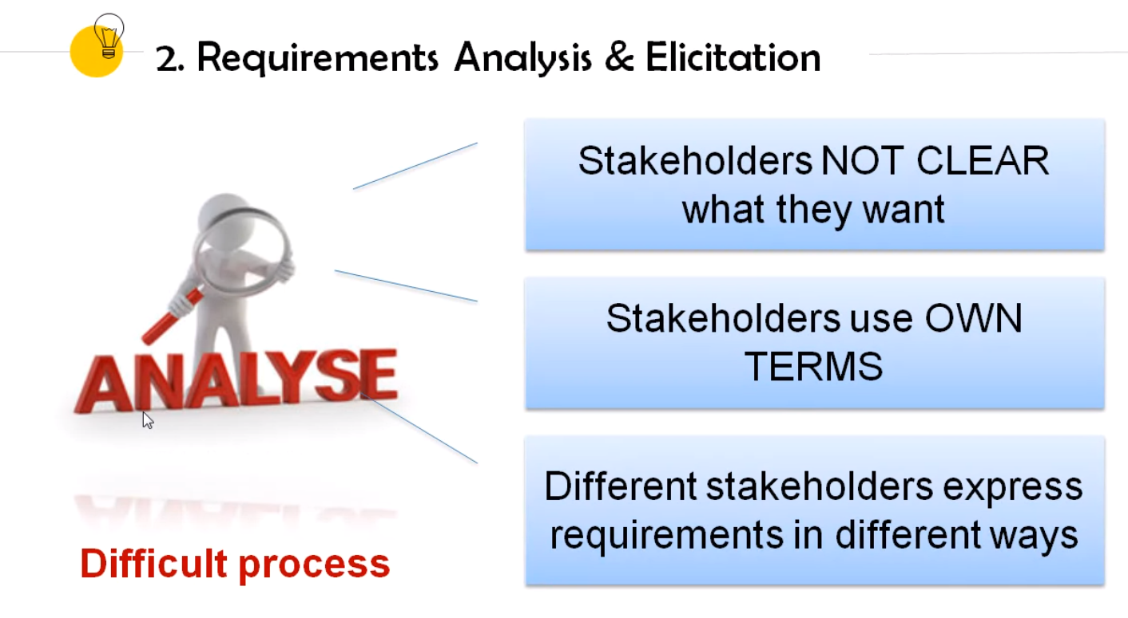
2. Requirements Analysis & Elicitation
It is a difficult process due to the following reasons:
Users/stakeholders are not clear on what they want from the computer system
Users/stakeholders normally express requirements in their own terms
Different Users/stakeholders have different requirements and they may express them in quite different ways
Analysis takes place in an organizational context and political factors may influence the requirements of the systems
The economic and business environment in which the analysis takes place is dynamic. It inevitably changes during the analysis process.
Notes:
Express requirements in own terms. E.g. camera shooting, memory shooting games in flash card system.
Different users/stakeholders have different requirements and they may express them in quite different ways. E.g. Manager → I want to see annual report end of the year. General Manager → I want to see annual report end of the year. → same requirements? Different requirements but expressed in same way.
E.g. same requirements expressed in different ways. CEO: I want to change employee’s salary, address, phone number anytime. General Manager: I want to update my team’s profile.

Slide 17
2. Requirements Analysis & Elicitation
Requirement Discovery
Requirement Classification & Organization
Requirement Prioritization & Negotiation
Requirement Documentation
Activities

Slide 18

2. Requirements Analysis & Elicitation
Requirement Discovery
Requirements Discovery
This is the process of interacting with stakeholders in the system to discover their requirements
Sources of information include:
Documentation
Stakeholders
Specification of similar systems
Etc.

Slide 19
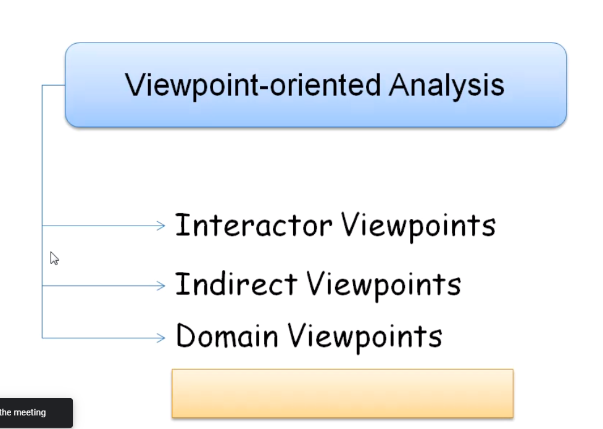
2. Requirements Analysis & Elicitation
Requirement Discovery
Viewpoint-oriented analysis is an approach that helps to ensure get broad stakeholder coverage when discovering requirements.
Viewpoints can be used to classifying stakeholders and other sources of requirements.

Slide 20
2. Requirements Analysis & Elicitation
Requirement Discovery
Viewpoint-oriented Analysis
Three generic types of viewpoints:
Interactor viewpoints – people or other systems that interact directly with the system (provide detailed system requirements like system features & interfaces)
Indirect viewpoints – stakeholders who do not use the system themselves but who influence the requirements in some way (provide high-level organizational requirements & constraints)
Domain viewpoints – domain characteristics and constraints that influence the system requirements (provide domain constraints)

Slide 21
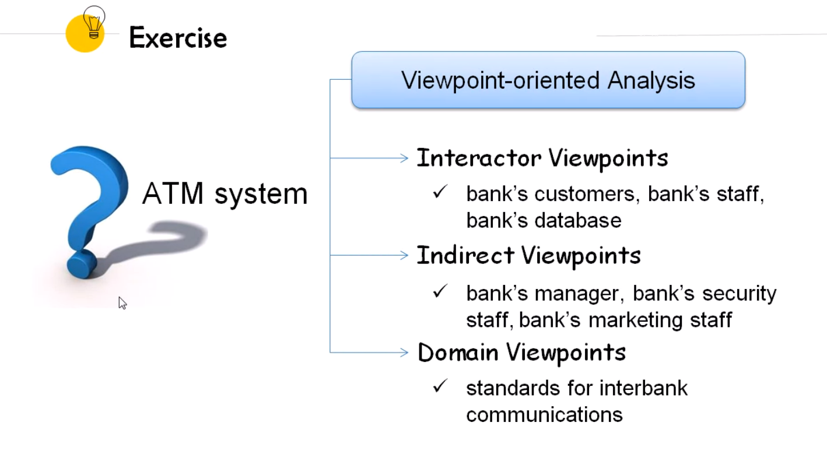

Exercise
Viewpoint-oriented Analysis
Interactor Viewpoints
ATM system
Indirect Viewpoints
Domain Viewpoints

Slide 22
2. Requirements Analysis & Elicitation
Requirement Discovery
Viewpoint-oriented Analysis
More specifics types of viewpoints include:
Providers and receivers of system services
Other systems interface directly with the system
Regulations and standards that apply to the system
Engineering viewpoints
Marketing and other viewpoints

Slide 23
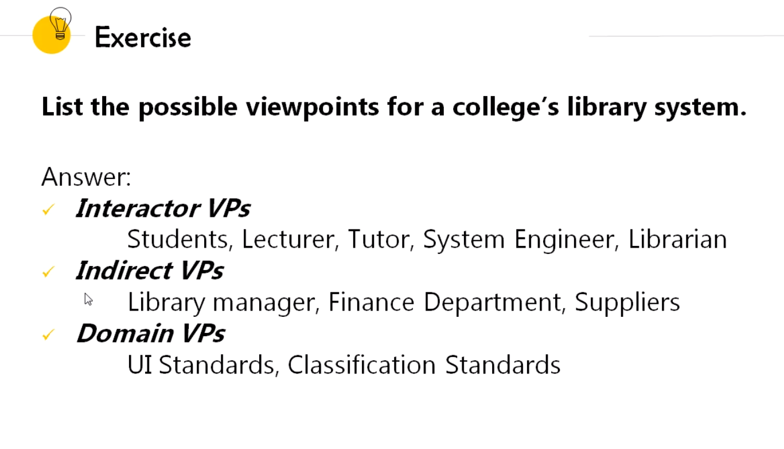
Exercise
List the possible viewpoints for a college’s library system.
Answer:
Interactor VPs
Indirect VPs
Domain VPs

Slide 24
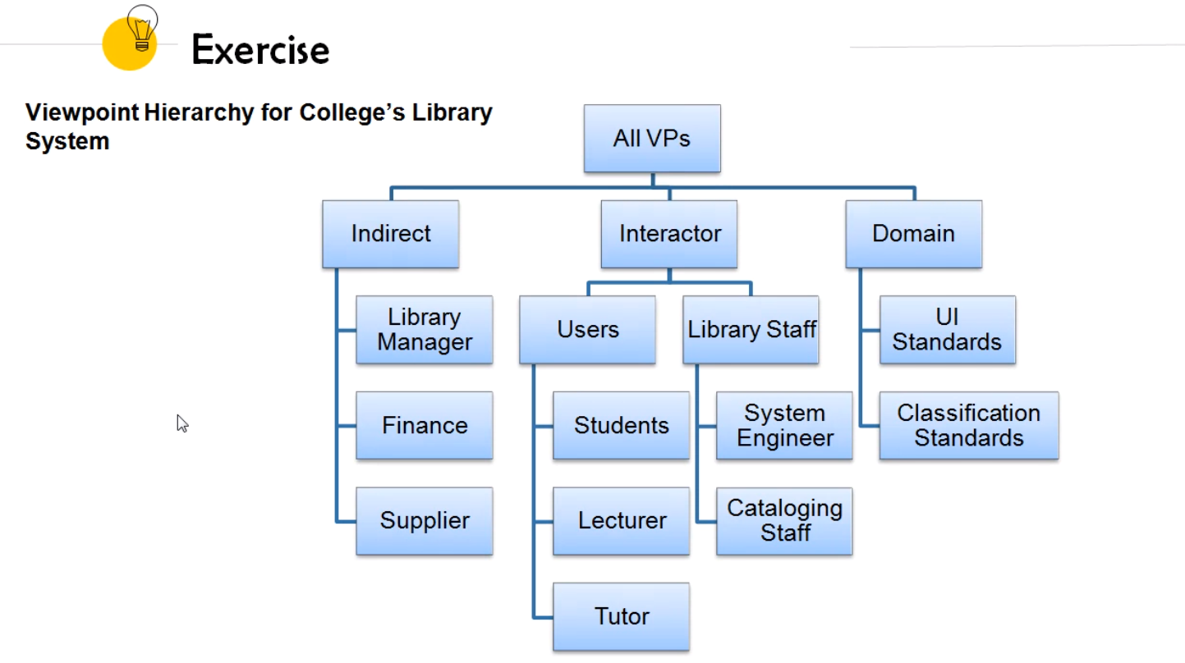
Exercise
Viewpoint Hierarchy for College’s Library System
All VPs
Indirect
Interactor
Domain

Slide 25
Exercise
Identify 5 viewpoints of an Online Hotel Room Reservation System and prepare a Viewpoint Hierarchy.

Slide 26
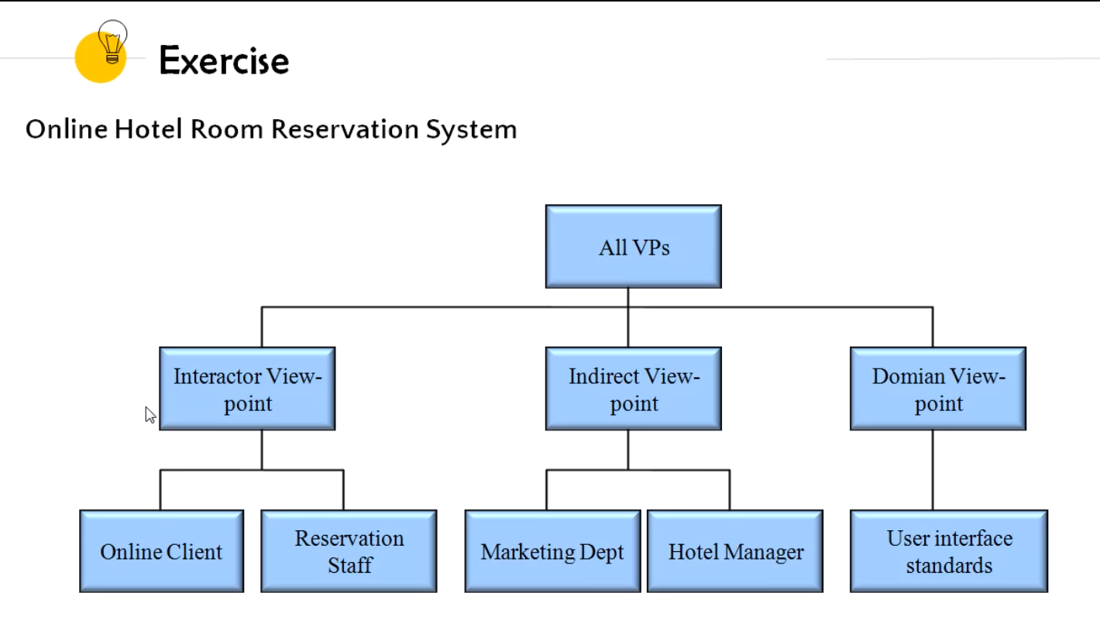

Slide 27
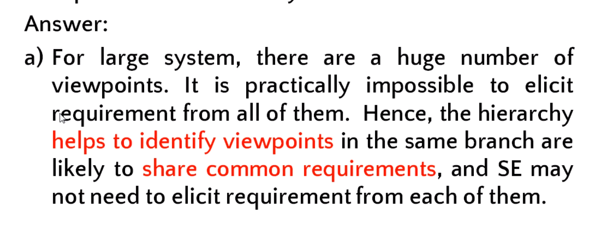
Exercise
It is important to organize and structure the viewpoints into a hierarchy. WHY?

Slide 28
Exercise
It is important to organize and structure the viewpoints into a hierarchy. WHY?
Answer:
a) For large system, there are a huge number of viewpoints. It is practically impossible to elicit requirement from all of them. Hence, the hierarchy helps to identify viewpoints in the same branch are likely to share common requirements, and SE may not need to elicit requirement from each of them.

Slide 29
Exercise
It is important to organize and structure the viewpoints into a hierarchy. WHY?
Answer:
b) To help ensuring all VPs are covered in the analysis and elicitation stage.
c) Help to decide whether a VP is a valid VP or not.

Slide 30
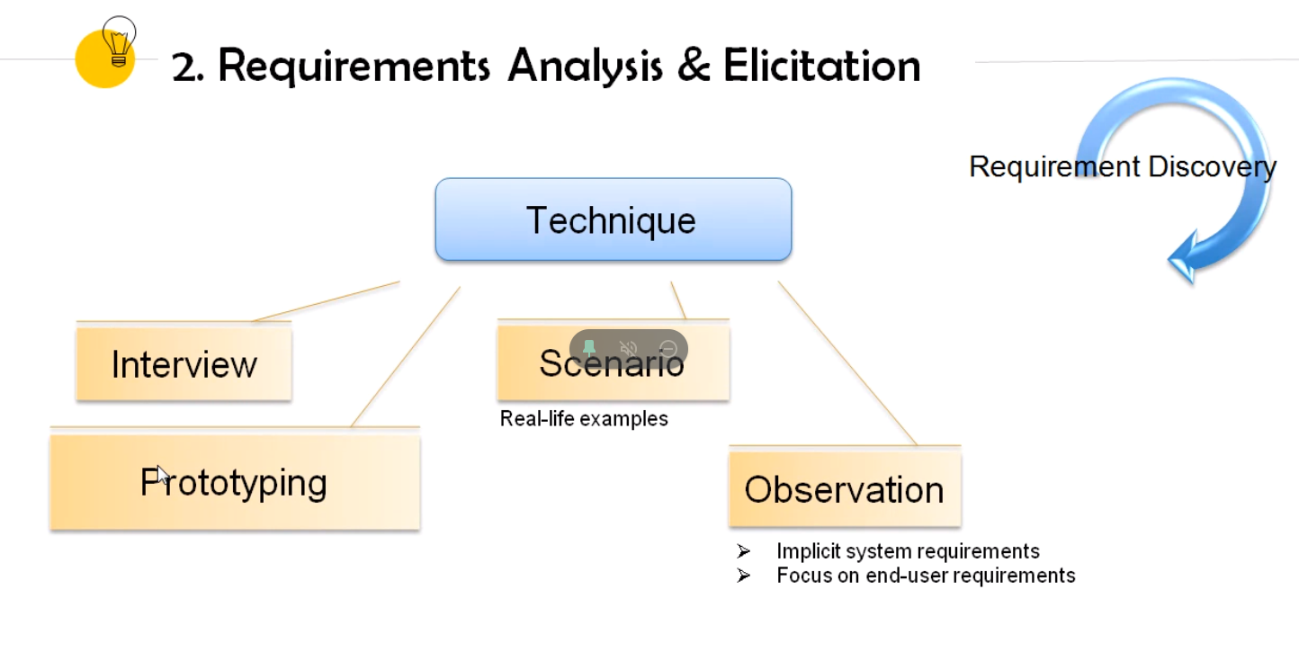
2. Requirements Analysis & Elicitation
Requirement Discovery
Techniques of req. discovery include:
i) Interviewing
open and closed questions may miss essential information
ii) Prototyping
(Discuss in chapter 6a)

Slide 31
2. Requirements Analysis & Elicitation
Requirement Discovery
Techniques of req. discovery include:
iii) Scenario
Stakeholders usually find it easier to relate to real-life examples than abstract descriptions.
Most general scenario are:
System and users expectation when the scenario starts
The normal flow of events
What can go wrong and how to handle
Info about other activities might go at the same time
System state when the scenario ends
Scenarios may written in text plus diagrams. For e.g. Event scenario and Use-cases scenario

Slide 32
2. Requirements Analysis & Elicitation
Requirement Discovery
Techniques of req. discovery include:
iv) Ethnography (Observation)
an observational technique to understand social and organizational requirements
Helps to discover implicit system requirements that reflect the actual rather than formal processes
Focuses on end-users requirements only

Slide 33

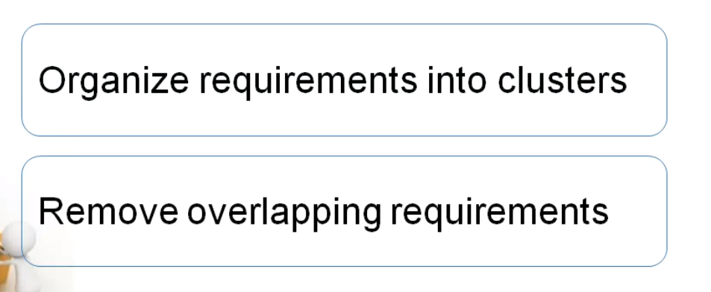
2. Requirements Analysis & Elicitation
Requirement Classification & Organization
This activity takes the unstructured collection of requirements and organizes them into coherent clusters

Slide 34
2. Requirements Analysis & Elicitation
Requirement Classification & Organization
Example: Hotel Management System
Customer
Registration
Check In
Room
Reservation
Check Out
Print Report

Slide 35
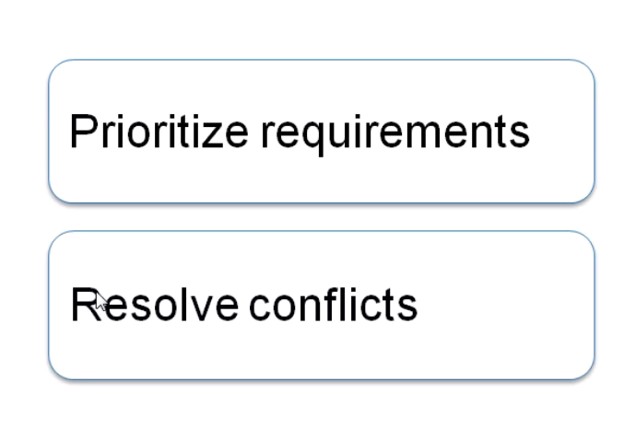

2. Requirements Analysis & Elicitation
Requirement Prioritization & Negotiation
Inevitable, where multiple stakeholders are involved, requirements will conflict. This activity is concerned with prioritising requirements, and finding and resolving these conflicts through negotiation

Slide 36

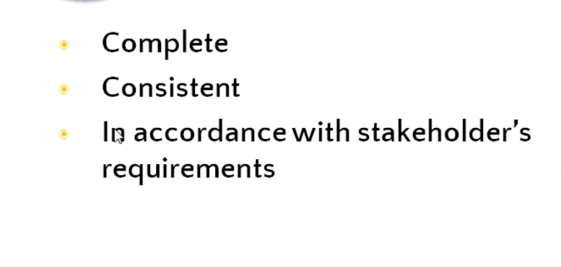
2. Requirements Analysis & Elicitation
Requirement Documentation
The identified requirements are documented and checked to discover if they are complete, consistent and in accordance with what stakeholders really want from the system
Formal and informal requirements documents may be produced

Slide 37
3. Requirements Specification
(Discussed in Chapter 4)

Slide 38
Revision
Requirement Engineering:
1. Feasibility Studies
2. Requirement Elicitation （1）and Analysis（2）
3. Requirement Specification (Discussed in Chapter 4)
4. Requirement Validation
5. Requirement Management

Slide 39

4. Requirements Validation

Slide 40
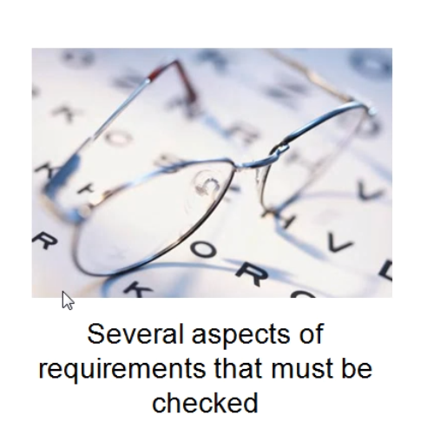
4. Requirements Validation
It is concerned with showing that the requirement actually define the system that the customer wants.

Slide 41
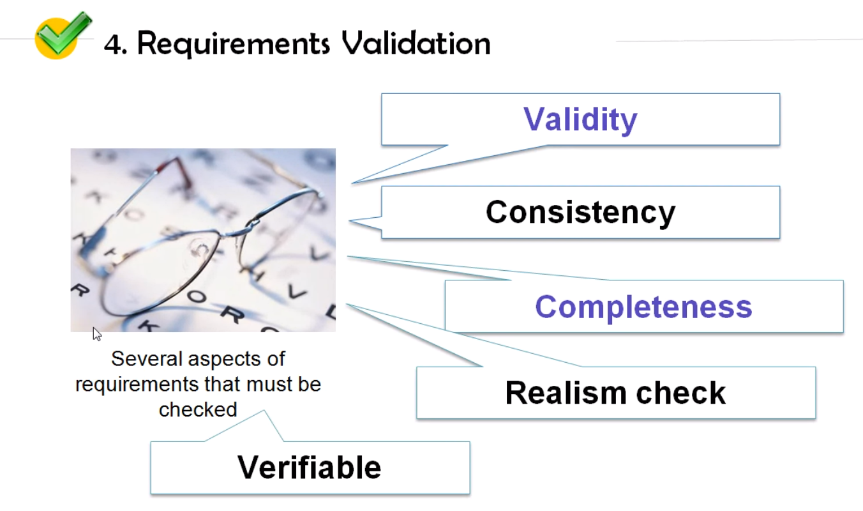

Slide 42

4. Requirements Validation
Several aspects of requirements that must be checked
Validity - functions user wanted is correct and confirmed needed
Consistency - no conflicting functions
Completeness - include ALL functions needed
Realism check – could be implemented (with existing technology, budget, schedule)
Verifiability – requirements are measurable? to reduce potential dispute (demo that the delivered system meets each requirements)
Notes:
Validity – all that system have included are what I want
Completeness – all that I want you have included

Slide 43
4. Requirements Validation
Example (Adapted): Electronic Library
Context:
“The purpose of this project is to create an attractive user-friendly prototype for a virtual archive (i.e. a virtual framework for virtual items or collection groups within a larger collection) of research materials”.
Requirement A: Item Retrieval
“This option allows the user to retrieve items in any format”.
Requirement B: No File Conversion
“File conversion should not be supported”.
Requirements Partitioning:
Requirement A tagged as a usability requirement
Requirement B tagged as a cost / schedule requirement
Conflict Identification:
QARCC’s expert knowledge system flags the possibility of a conflict due to the fact that usability and cost / schedule requirements typically stand a good chance of conflicting with each other. The conflict is then verified by the development team with the following issue: “What is meant by any formats? It may not be possible to retrieve in any format since file conversion will not be supported”.

Slide 44
Exercise
What are the methods can be used to validate user requirements?
Answer:
Prototyping
Structured walkthrough
Formal technical reviews

Slide 45

5. Requirements Management

Slide 46

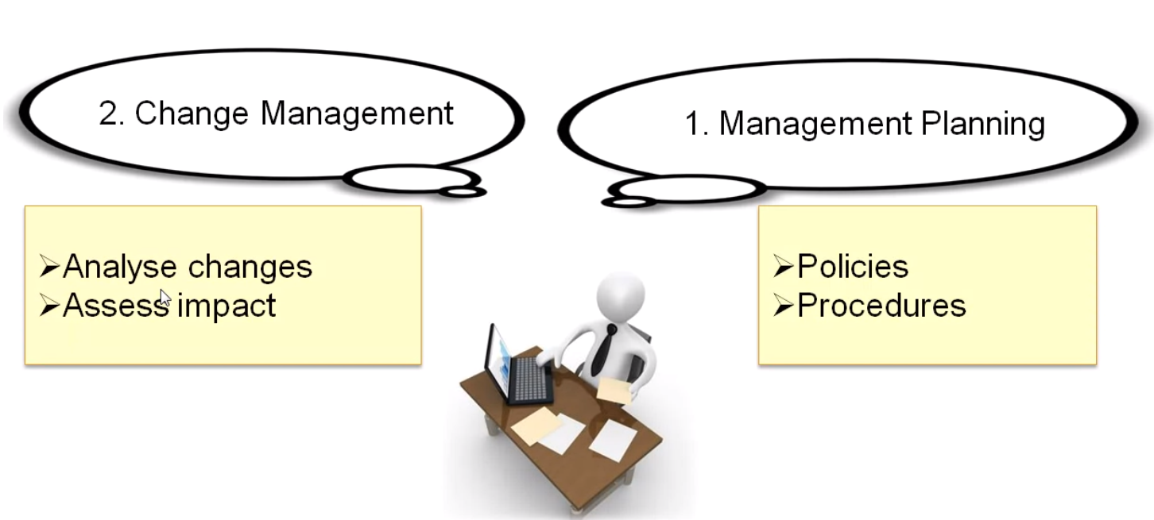
5. Requirements Management
This process includes :
Management planning - where policies and procedures for requirements management are designed and specified
Change management - where proposed requirements changes are analyzed and their impacts are assessed.

